Slide 1


College student food insecurity: CalFresh benefits
August 23, 2019

Slide 2
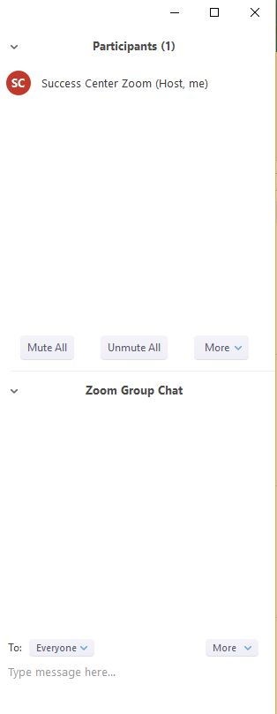
Information to participate
Connect through your computer by clicking on the link, or connect by phone:
  Call-in number: 1-646-876-9923
  Meeting ID: 107 017 344
  To submit questions, use the Chat Panel, type your question, and press Enter
  Webinar will be recorded, and slides will be available

Slide 3
Today’s Agenda
History of the work and current efforts
Data and reports on student food insecurity
CalFresh background and basics
CalFresh eligibility basics for college students
How to apply for CalFresh benefits
CalFresh Outreach Overview
Q&A

Slide 4
Today’s Presenters
Jenny Fales, CSU Chico’s Center for Healthy Communities
Colleen Ganley, California Community Colleges Chancellor’s Office
Jessica Smith, Foundation for California Community Colleges

Slide 5

History of the work:
CCC Food, Housing & Basic Needs Resources 2017 Survey
In Fall 2017, the Chancellors Office conducted the Food, Housing, and Basic Needs Resources Survey
Survey requested information about resources currently available to support CCC students with basic needs insecurity
214 responses, representing 104 of the 114 CCCs

Slide 6
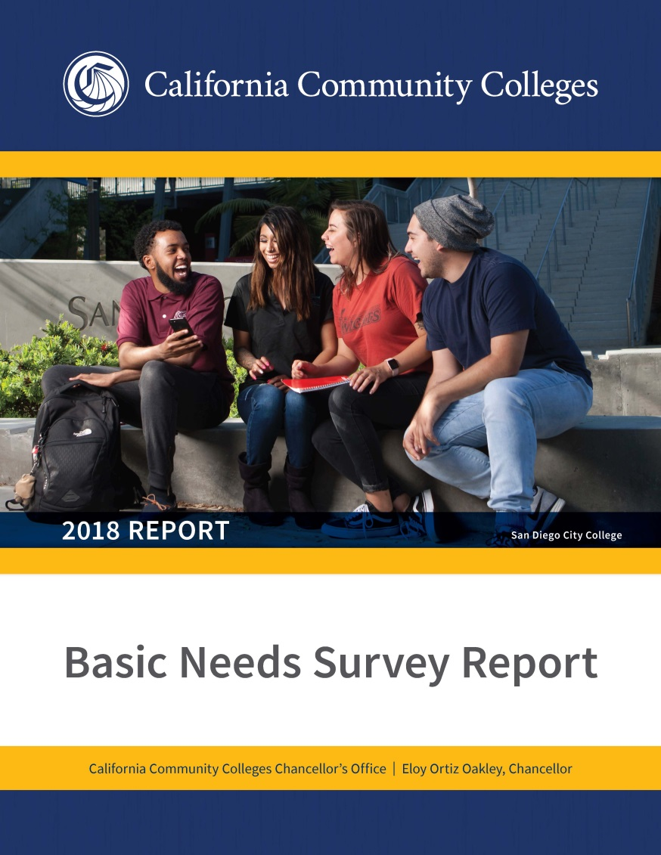
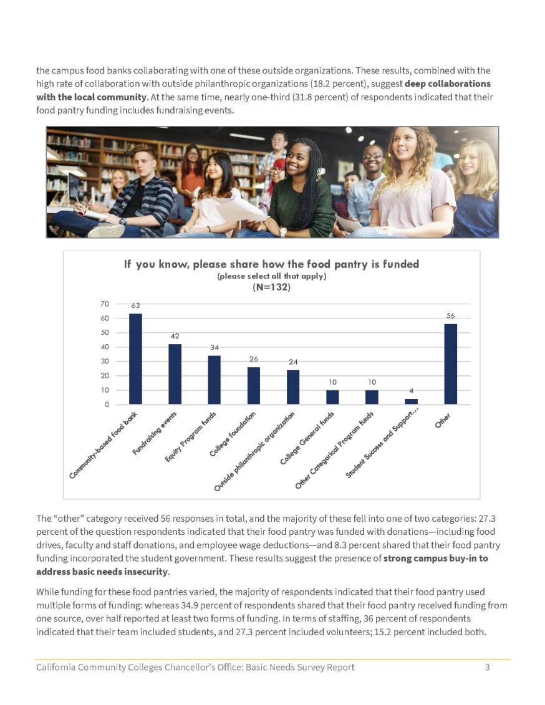
History of the work:
CCC Basic Needs Survey 2018 Report
  With information from the 2017 Survey, the Chancellor’s Office developed the Basic Needs Survey Report
    Provided base line data regarding available resources
    Provided best practices and featured best practice models
    Allowed for the creation of a comprehensive directory including CCC points of contact/liaisons
    Available at cccstudentmentalhealth.org

Slide 7

2018 #RealCollege Survey
The Chancellor’s Office provided support to The Hope Center to administer the 2018 #RealCollege survey across California Community Colleges system
  57 CCCs participated in the survey
  40,000 students responded
  Full report is available at cccstudentmentalhealth.org

Slide 8

HOPE lab Report 2019
Of the 40,000 students responses:
  50% of respondents were food insecure in the prior 30 days
  60% of respondents were housing insecure in the prior 12 months
  19% of respondents were homeless in the previous 12 months

Slide 9
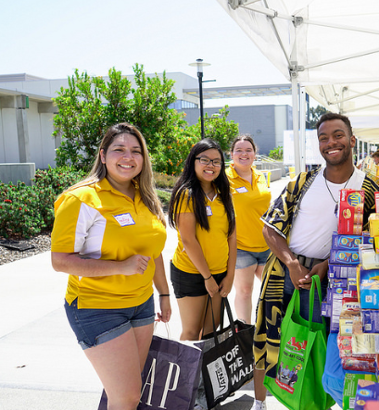
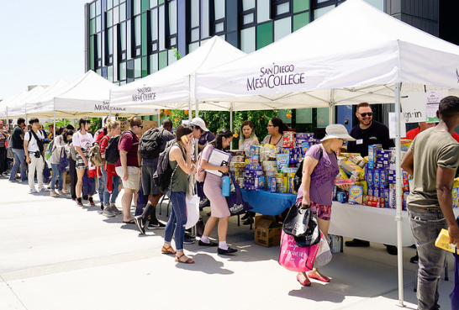
CCC Hunger Free Campus funding
State budget included funds to support CCC Hunger Free Campus activities including:
    CalFresh Enrollment Support Services
    Establish or Expand Campus Food Pantry services
2017-18 $2.5 million
2018-19 $10 million
2019-20 $3.9 million

Slide 10

CCC Hunger Free Campus Activities
Creating Basic Needs Resource Centers
Mobile Food Vans
Hot Meal Voucher
Meal Donation Give Back Programs
Financial Literacy Programs
Farmers’ Market Donation Programs
Community Garden Programs

Slide 11
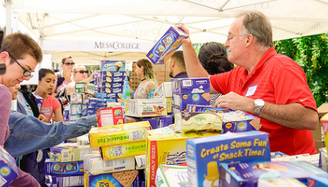
CCC Hunger Free Campus baseline data
114 CCCs report hosting food pantry or regular food distribution
1,525 CCC faculty & staff providing support to students enrolling in CalFresh
15,000 students supported with CalFresh enrollment services
50 CCCs report having Basic Needs Centers

Slide 12
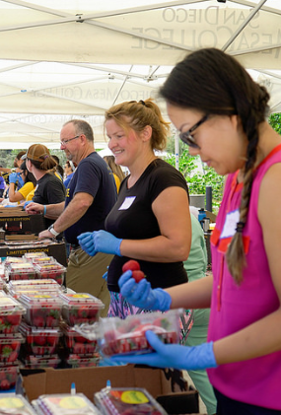
Other Food Security Activities
Working with California Higher Education Basic Needs Alliance (CHEBNA): an intersegmental Basic Needs partnership with the UC and CSU systems
CHEBNA 2020 Summit coming February 2020
Electronic Benefit Transfer Case Study
CalFresh Outreach toolkits from the Chancellor’s Office will be distributed to all 114 campuses
CalFresh Outreach Video

Slide 13
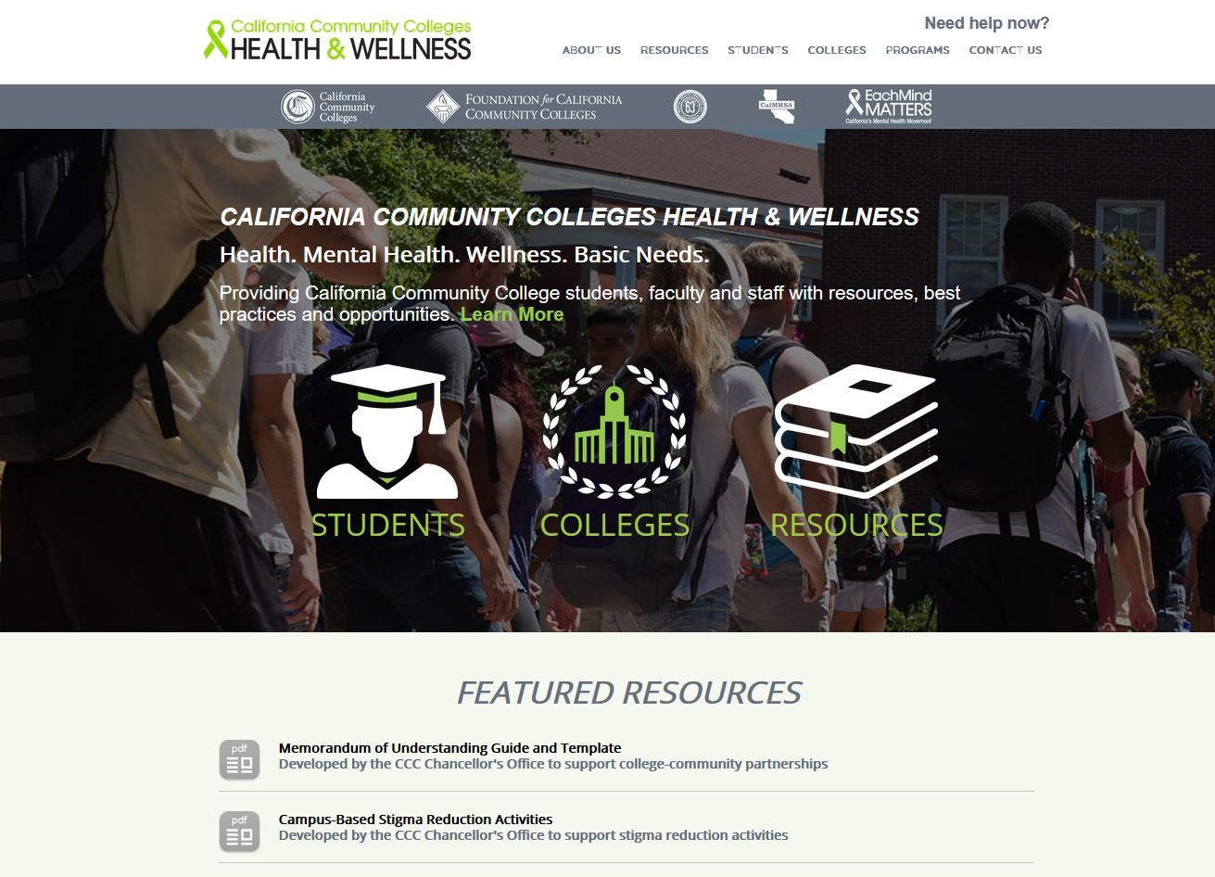
cccstudentmentalhealth.org
Resources at:
    Basic Needs Summary Report
    Campus Basic Needs Webpages
    Basic Needs Best Practices
    Homeless Youth Liaisons Directory & Informational Guidelines
    And more!

Slide 14
What is CalFresh?
CalFresh is a federally funded, sustainable intervention for student hunger.
Many students are eligible for CalFresh benefits, which feeds students and their families.
Funded by USDA SNAP, known in California as CalFresh, an equal opportunity provider and employer, and the California Department of Social Services

Slide 15
CalFresh benefits as an intervention
CalFresh is a nutrition program that can help households (including students) to buy healthy foods.
CalFresh is California’s SNAP (food stamps) program.
CalFresh benefits are issued on an EBT card that works just like a debit card. You can use your debit card at most grocery stores and farmers’ markets.

Slide 16
The History of Food Stamps – SNAP -
CalFresh Food
1930’s - Great Depression Surplus
1960’s - War on Poverty
1970’s - Expansion
2008 – Name change
16
Notes:
https://www.fns.usda.gov/snap/short-history-snap#1939
https://www.snaptohealth.org/snap/the-real-benefits-of-the-snap-program/

Slide 17
CalFresh Food Funding
17
Notes:
CalFresh Food, federally known as Supplemental Nutrition Assistance Program (SNAP), funded through the Farm Bill, USDA, FNS, and CDSS
USDA FNS - Administers the Federal food and nutrition assistance programs
This provides better access to food across across counties and states
FNS also promotes healthy eating through SNAP-Ed nutrition education programs
CalFresh provides eligible households additional resources to buy food at any store that accepts EBT
CalFresh is a nutrition program that provides jobs and stimulates the economy
County’s role vs. CFO role

Slide 18

EBT = Electronic Benefits Transfer
No legitimate county representative will ever call a recipient to ask for their PIN – potential scams should be reported by calling (877) 328-9677
Case Number
Notes:
CA CalFresh Benefits are provided on a the Golden Advantage EBT card, looks and is used like a debit or credit card - holds cash aid too
The case number under their name, 15 numbers, ignore the first two numbers, the following 7 numbers are a client's case number.
Can be used in other counties or states, can be used at self checkout
A note about EBT scams
If a recipient receives a text or phone call asking for personal information, THEY SHOULD NEVER PROVIDE ANY INFORMATION. No legitimate state or county representative would ever ask for the PIN. If someone thinks their benefits may have been stolen, instruct the recipient to immediately call the customer service telephone number on the back of their EBT card, at (877) 328-9677 or contact their county. Learn more about protecting EBT Cards here: http://www.cdss.ca.gov/EBT-Card

Slide 19
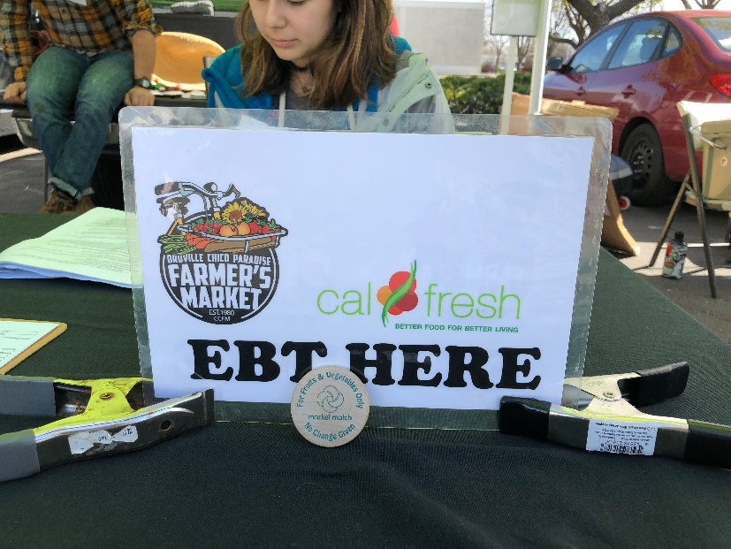

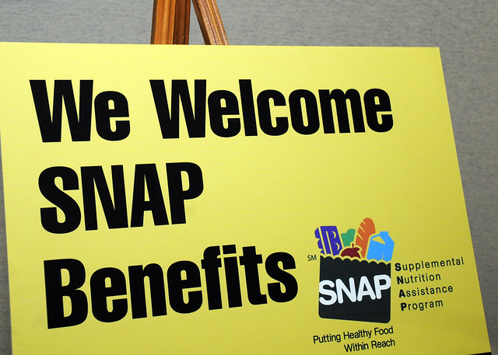
Where can you use CalFresh food?
To see stores that accept CalFresh Food EBT, visit EBTNearMe.org
Many farmers’ markets will accept CalFresh Food plus have Market Match . To find markets, visit FMFinder.org.

Slide 20
Other benefits of an ebt card
PG&E CARE Program
California LifeLine
Free or reduced entry to museums
Amazon Prime discount
Low Cost Auto Insurance

Slide 21

CalFresh eligibility
CalFresh determines eligibility based off household and income.
  If an applicant is a student, there will be other eligibility requirements (will cover in the next few slides)
How does CalFresh define a “household”?
  An individual or unit of individuals that purchase and prepare food together.
A CalFresh household must meet income guidelines and reside in California as a legal resident or citizen.

Slide 22
CalFresh income eligibility guidelines
(figures effective oct.1, 2018 – Sept.30, 2019)
MONTHLY INCOME LIMITS
NUMBER OF PEOPLE IN HOUSEHOLD | GROSS MONTHLY INCOME
1 | $2,024
2 | $2,744
3 | $3,464
4 | $4,184
5 | $4,904
6 | $5,624
Benefit amounts range from $15 -$192 per month; average of $150 per month for a household of 1
To find the maximum monthly income amounts, visit mycalfresh.org/the-basics/

Slide 23
Student Eligibility
Others not considered a “student” under CalFresh eligibility can disregard student rules and apply normally
Between the ages of
18 and 49
Enrolled at least half time
(typically 6 units/
semester CCC)
“Student”

Slide 24
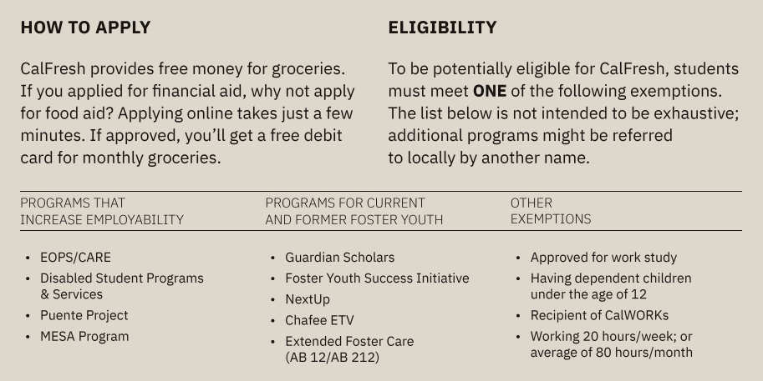
Student eligibility

Slide 25
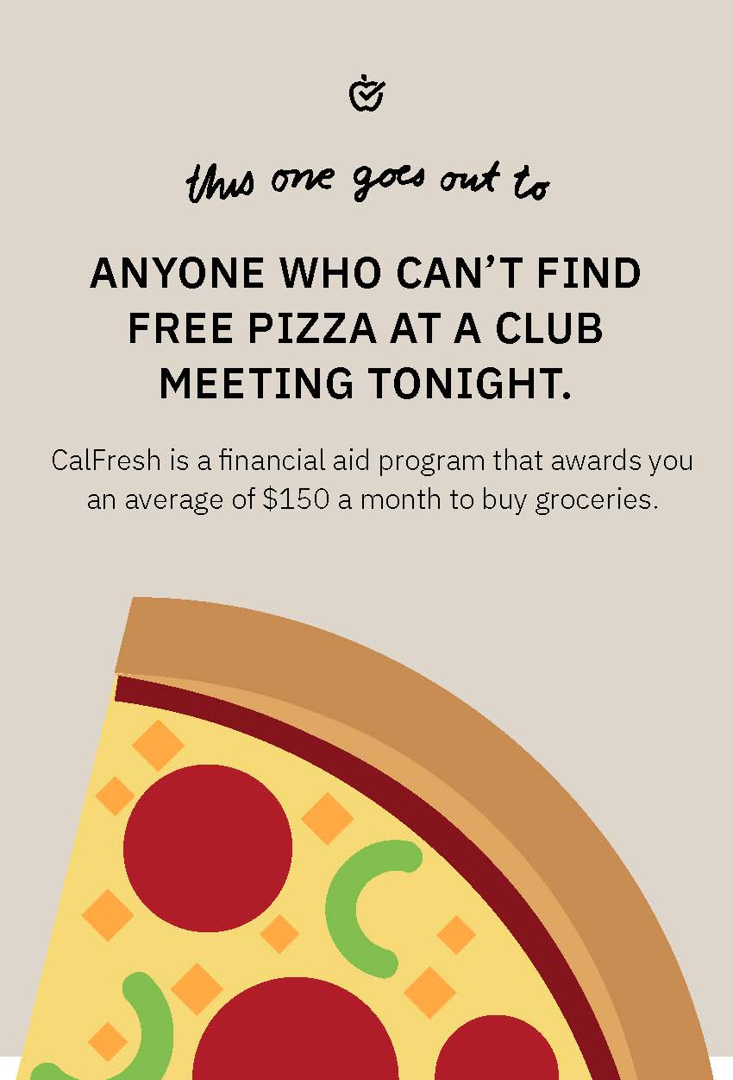
Students can apply online at:
students.getcalfresh.org/s/ccc

Slide 26



Encourage students to apply!
Eligibility is based off income, household size, student status, and several other factors
“Congrats! You applied for (or qualified for) financial aid, now don’t forget to apply for ‘food aid’”
Many students don’t even know they are eligible

Slide 27
CalFresh Outreach Program
The vision of the CalFresh Outreach CA Higher Ed program is to support development of college campus onsite CalFresh Outreach programs integrated with other related services.
27

Slide 28
CalFresh Outreach Program
GOALS
Spread correct, unbiased information about the program
Assist people through the application and verification process
Work in partnership with state and county social service offices
Provide bilingual support and create resources
Help interpret county notices, problem solve, and overcome the three hurdles
The Three Hurdles: Application, Interview, and Verifications

Slide 29
Upcoming in part 2
(date & time to be announced)
Outreach strategies
Get the conversation going – destigmatize CalFresh
Campus guest panelist – campus TBD
Outreach toolkits & outreach materials
CalFresh Outreach student ambassadors pilot

Slide 30
Questions?
Please submit your questions into the chat box

Slide 31

Contact us
Jenny Fales, CSU Chico’s Center for Healthy Communities: jefales@csuchico.edu
Colleen Ganley, California Community Colleges Chancellor’s Office: cganley@cccco.edu
Jessica Smith, Foundation for California Community Colleges: jsmith@foundationccc.org

